Slide 1

Startup Presentation
Here is where your presentation begins

Slide 2
Introduction
Imagine you have an idea for a business, a project, and you want to put it online. But you're not a tech expert, and you don't have a huge budget.
Our Startup is like your personal team of website builders. They:
Design your website to look great and be easy for people to use (UI/UX design).
Build the website from scratch, so it's exactly what you need.
Host the website, which is like giving it a home on the internet.
Maintain it, making sure everything is always working, secure, and up-to-date.
Our promise is to do all of this for a price you can actually afford, so anyone can have a professional online presence without the high costs.

Slide 3
The Problem
The Digital Gap: Small businesses, freelancers, and passion project owners know they need a professional online presence, but face massive barriers..
The Pain Points:.-
High Cost: Traditional agencies charge exorbitant fees for fragmented services..
Complexity: The process is overwhelming-you need a designer, a developer, a host , and a maintenance team..
Time & Effort: Managing multiple vendors and a complex project timeline is a full-time job..
Poor Digital Experience: Weak UI/UX and inconsistent branding result in low user engagement and disappointing conversion rates.
Video Content Barriers: Professional video creation remains costly and complex, limiting effective marketing reach.
Fragmented Services: You get a website, but what about a logo, branding, or app UI/UX? These are separate, expensive services.

Slide 4
The Solution
Our Promise: We are the all-in-one digital presence team for everyone..
How We Solve It: We offer a single, unified service package that covers every aspect of building and maintaining a professional online presence..
Our Core Services:. Website Design & Development: Custom, user-friendly, and responsive websites..
UI/UX Design: For websites and apps, ensuring a seamless user experience..
Hosting & Maintenance: We manage everything, from security updates to server uptime..
Creative Services: Logo design, brand identity, and video editing to bring your vision to life.
Value Proposition: We deliver a complete, high-quality digital solution at an affordable ,transparent , and all-inclusive price.

Slide 5
Target Market
Our Target Market: We are not targeting large enterprises. Our focus is on the rapidly growing segments of:.
Small and Medium Enterprises (SMEs).
Individual Freelancers and Entrepreneurs.
E-commerce Startups.
Bloggers and Content Creators.

Slide 6
Our Complete Digital Ecosystem
We've reimagined digital services delivery through an integrated, affordable approach that transforms how businesses establish their online presence.
Web Development
Brand & Design
Digital Marketing
Web Development
Brand & Design
Digital Marketing
Complete brand identity creation from logo design to comprehensive style guides. UI/UX design for websites and mobile applications, ensuring exceptional user experience and conversion optimization.
Logo and brand identity.
UI/UX design for web and mobile.
Brand guidelines and assets Print and digital marketing materials.
Custom websites built from scratch using modern frameworks. Responsive design ensuring perfect performance across all devices. Advanced functionality including e-commerce, booking systems, and CRM integration.
Custom coding and development.
E-commerce solutions.
Mobile-first responsive design.
SEO optimization.
Strategic content creation including video editing, social media management, and digital advertising campaigns. Data-driven approach to maximize ROI and accelerate business growth.
Video editing and production
Social media management
Content strategy and creation
Digital advertising campaigns
Custom websites built from scratch using modern frameworks. Responsive design ensuring perfect performance across all devices. Advanced functionality including e-commerce, booking systems, and CRM integration.
Custom coding and development.
E-commerce solutions.
Mobile-first responsive design.
SEO optimization.
Strategic content creation including video editing, social media management, and digital advertising campaigns. Data-driven approach to maximize ROI and accelerate business growth.
Video editing and production
Social media management
Content strategy and creation
Digital advertising campaigns
Unlike fragmented service providers, we deliver end-to-end solutions under one roof, ensuring brand consistency, streamlined communication, and significant cost savings for our clients.

Slide 7
The Business Model
Revenue Streams: We operate on a hybrid model that ensures predictable revenue..
Project-Based Fees: One-time fees for website creation, logo design, or app UI/UX..
Subscription Model: Affordable monthly or annual subscription plans for ongoing hosting, security, and maintenance. This creates a stable, recurring revenue stream..
Pricing Strategy: Simple, transparent packages (e.g., Basic, Pro, E-commerce) with clear deliverables, eliminating hidden costs and confusion for clients.

Slide 8
Swot analysis
Strengths
Weakness
Limited brand recognition in a crowded market..
Initial reliance on a small team of generalists..
Potential for burnout if not managed properly.
All-in-one service model.· Affordable and transparent pricing..
Expertise in UI/UX and other creative services..
Strong focus on customer satisfaction and support.
Threats
Opportunities
New, well-funded competitors entering the market..
Rapidly changing technology requiring constant skill updates..
Economic downturn affecting small business spending.
Explosive growth in the SME
and freelancer market..
Demand for affordable, comprehensive digital services..
Expansion of services into app development and digital marketing.

Slide 9
Competitive Analysis
The Landscape:-
Freelancers: Inconsistent quality, reliability, and service offerings. No one-stop solution..
Ai Platforms (e.g., Wix , Squarespace): Limited customization, poor scalability, and clients still need to do all the design and content work themselves.
How We Are Different:-
All-in-One Solution: We are the single point of contact for all digital needs..
Affordability: Our packages are designed for the budget-conscious, unlike traditional agencies..
Personalized Service: We are a dedicated team, not a faceless platform. We build long-term
relationships..
Holistic Approach: We don't just build a website; we build a complete brand presence including logos, UI/UX, and more.

Slide 10
Table of contents
01
02
03
04
Problem vs solution
Startup Overview
Market & competition
Business model

Slide 11
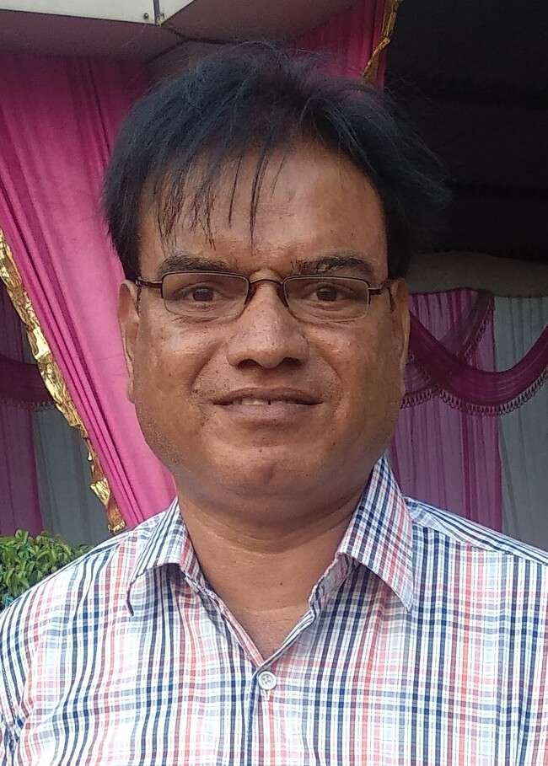
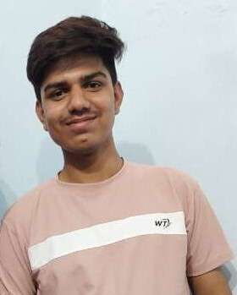
Our team
Santosh Kumar Soni
Ronit Soni
Founder
Co-Founder
Frontend Developer

